Slide 1

Data Discretization
Presented by:
Elizer Ponio Jr.
Department of Computer Science
College of Computing and Information Technologies

Slide 2
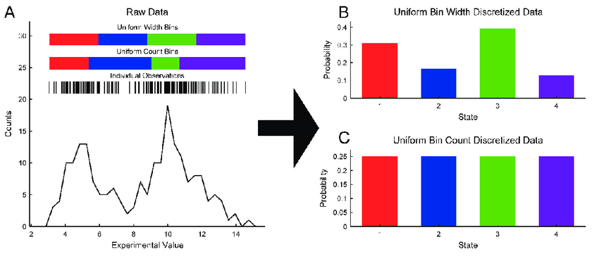
What is Discretization?
Data discretization is defined as a process of converting continuous data attribute values into a finite set of intervals with minimal loss of information and associating with each interval some specific data value or conceptual labels.
It is a crucial data preprocessing technique used in of data analysis

Slide 3
Continuous vs Discrete Data
A set of data is said to be continuous if the values belonging to the set can take on any value within a finite or infinite interval | A set of data is said to be discrete if the values belonging to the set are distinct and separate
Measured
Counted

Slide 4
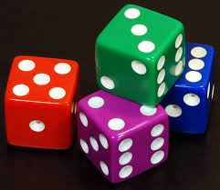
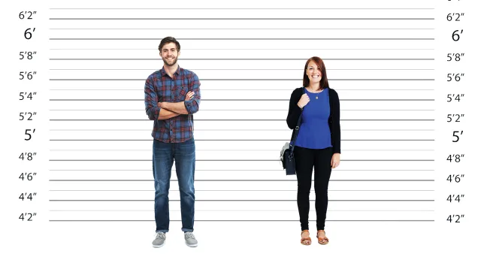
Continuous vs Discrete Data
Measured
Counted
Height of a person can range anywhere between 0 to 7 feet tall
Dice rolls can only be 1 or 2 or 3 or 4 or 5 or 6

Slide 5
Continuous vs Discrete Data
Measured | Counted
Height of a person | Number of persons living in a house
Length of a leaf | Number of dry leaves in a plant
Speed of a vehicle | Number of vehicles caught for speeding in a highway

Slide 6
Why convert Continuous data to Discrete Data?
Prepares data for further analysis, e.g., classification.
Diminishes data from a large domain of numeric values to a subset of categorical values.
There is a necessity to use discretized data by some algorithms which can only deal with discrete attributes.
Easy maintainability of the data.
Improves the quality of discovered knowledge.

Slide 7
Why convert Continuous data to Discrete Data?
Step 1: Sorting the continuous values of the feature to be discretized.
Step 2: Evaluating a cut point for splitting or adjacent intervals for merging.
Step 3: Splitting or merging intervals of continuous values according to some defined criterion.
Step 4: Stopping at some point.

Slide 8
Example: Human Age Discretization
Given this continuous data:
1, 77, 9, 4, 70, 11, 42, 17, 13, 18, 19, 31, 33, 36, 14, 44, 46, 7, 74, 78, 5
1, 5, 9, 4, 7, 11, 14, 17, 13, 18, 19, 31, 33, 36, 42, 44, 46, 70, 74, 78, 77
Step 1: Sort the continuous values in ascending order

Slide 9
Example: Human Age Discretization
1, 5, 9, 4, 7, 11, 14, 17, 13, 18, 19, 31, 33, 36, 42, 44, 46, 70, 74, 78, 77
1, 5, 9, 4, 7 | 11, 14, 17, 13, 18, 19 | 31, 33, 36, 42, 44, 46 | 70, 74, 78, 77
Step 2: Evaluate a cut point for splitting

Slide 10
Example: Human Age Discretization
1, 5, 9, 4, 7 | 11, 14, 17, 13, 18, 19 | 31, 33, 36, 42, 44, 46 | 70, 74, 78, 77
Child | Young | Mature | Old
1, 5, 9, 4, 7 | 11, 14, 17, 13, 18, 19 | 31, 33, 36, 42, 44, 46 | 70, 74, 78, 77
Step 3: Splitting or merging intervals of continuous values according to some defined criterion

Slide 11
Discretization Techniques
Binning. Binning smooths a sorted data value by consulting its “neighborhood”, that is the values around it. The sorted values are distributed into several “buckets” or bins.
Histogram Analysis. A histogram partitions the values of an attribute, into disjoint ranges, called buckets or bins. it does not use class information.
Cluster Analysis. Partitions the values into clusters or groups based on similarity, and store cluster representation.
Correlation Analysis. It is performed recursively by finding best neighboring intervals that have a similar distribution of classes and merge them, until a predefined stopping condition. it uses class information

Slide 12
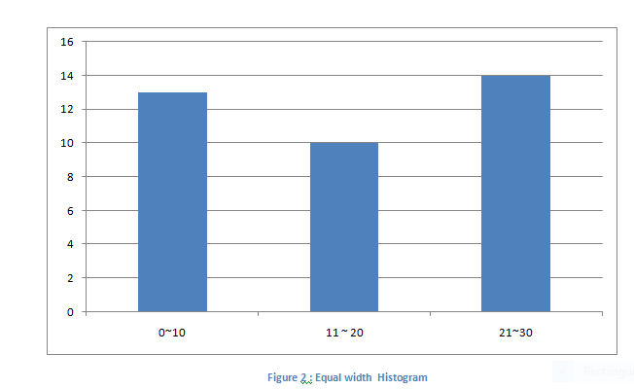
Discretization By Histogram
Given this continuous data:
1,1,4,4,4,4,7,7,9,9,9,9,9,11, 13,13,13,17,17,17,17,17,17, 21, 21, 21, 21, 25, 25, 25, 25, 25, 28, 28, 30,30, 30

Slide 13
Summary
Data discretization is a valuable preprocessing technique that transforms continuous data into a more manageable and interpretable form, enabling better analysis and modeling in various domains.
However, it should be applied judiciously, considering the nature of the data and the specific goals of the analysis or modeling task.

